Slide 1
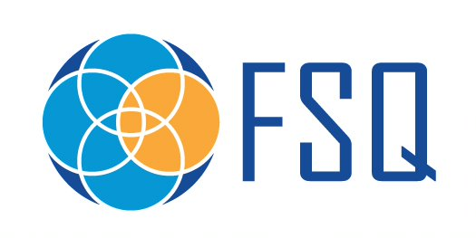
 |  | Created By | Karl Thorson
 | Cleaning Method Order of Preference Master Slide | Creation Date | 04/08/2020
 |  | Revised By | N/A
 |  | Revision Date | N/A
Change Log
Date | Revised By | Description of Change
\\genmills.com\ITQ\SCOE\Master_Slides\Cleaning_Method_Order_Of_Preference_MASTER.pptx

Slide 2





Cleaning Method – Order of Preference 清洁方法 - 选择次序
No cleaning needed 无需清洁
Redundant or dedicated equipment 备用或专用设备
Purge (next product or inert material)
净化/清除（下个产品或惰性材料)
Dry clean 干清洁
Dry clean w/chemicals 干清洁
CIP (Clean in Place) 就地清洁
Controlled wet clean – out of place 受控的湿清洁 (清洗间）
Automated washer 自动清洗机
ACS (Assisted Cleaning System) 辅助清洁系统
Controlled wet clean – in place 受控的湿清洁 - 在适当的地方
Flood cleaning 浸没清洁
Notes:
**CHINESE**
1. The ideal state is to design for no cleaning as cleaning is not a value-added process for our consumer (see Value Stream Mapping). However, it is a critical process to providing safe quality food, but we should work to minimize its impact to the business as much as possible. Creating systems with redundant and dedicated equipment help drive down Planned Losses. 理想的状态是设计为不用清洗，因为清洗对我们的消费者来说不是一个增值过程(见价值流映射)。然而，这是一个提供安全优质食品的关键过程，但我们应该尽量减少其对企业的影响。创建具有备用和专用设备的系统有助于降低计划中的损失。 Examples 举例: dedicated equipment to a specific allergen to prevent the need to clean and inspect the system related to removing that specific protein the significant resources need to meet that goal. 专用设备用于特定的过敏原，以防止需要清洗和检查与去除特定蛋白质相关的系统，这是实现该目标所需的重要资源。 Redundant equipment so that it can be pulled offline quickly during a flavor changeover and replaced for a faster start up of the system 备用设备，以便在口味转换期间可以快速脱机并替换为系统的更快启动 2. Purging the system to remove most, but not all, of the product/ingredient to meet the changeover success criteria. A clear standard of how much remaining material can be left in/on the system needs to be clearly agreed to and communicated (photo standards, etc). 对系统进行清洗，除去大部分(但不是全部)产品/成分，以满足转换成功标准。关于系统中/上可以留下多少剩余材料的明确标准需要得到明确的同意和沟通(照片标准等)。 Examples举例: Pushing the previous product with the next formula for a given time/weight/volume to meet a sensory standard (removing color, flavor, etc) Flushing with an inert material like salt to help abrade away the previous material 在给定的时间/重量/体积内，用下一个配方推动上一个产品以达到感官标准(去除颜色、味道等) 用一种像盐一样的惰性物质冲洗，以帮助磨蚀之前的物质 Dry cleaning with no water or chemicals should be prioritized to minimize the impact of water and chemicals on our people, equipment, and the environment. We want to collect the soil not spread it so use of compressed air is strongly discouraged. Vacuum, scrape, or brush the soil to efficiently and effectively get it into a waste container. 没有水或化学品的干洗应优先考虑，以尽量减少水和化学品对我们的人，设备和环境的影响。我们希望收集污垢而不是散布它，所以使用压缩空气是强烈不鼓励的。用吸尘器、刮土或刷土来有效地将污垢放入废物容器中。 Dry cleaning with chemicals to help loosen/release the soils may be needed in some cases.在某些情况下，可能需要用化学物质进行干洗来帮助污垢松驰。 If water use is absolutely necessary then having a fully automated, closed loop system is the best option to control the key steps and parameters of cleaning.如果用水是绝对必要的，那么有一个全自动的闭环系统是控制清洗的关键步骤和参数的最佳选择。 If possible, move equipment for wet cleaning to an area designed for cleaning and control water. The first choice is to utilize an automated washer (cabinet, tunnel, etc) to ensure reparability and control of all steps and parameters. Automated cleaning is always preferred to the variability of human cleaning tasks. 如果可能的话，将湿式清洗设备移到设计用于清洗和控制水的区域。第一种选择是使用自动洗衣机(机柜、隧道等)，以确保所有步骤和参数的可维修性和可控性。与人工清洁任务的可变性相比，自动清洁总是首选的。 Assisted Cleaning Systems are closed loop system without full automation like CIP and require more resources to manage. 辅助清洗系统是闭环系统，不像CIP那样完全自动化，需要更多的资源来管理。 If the components can’t be moved to a wash area, then clean in place methods like utilizing a bucket and brush must be used. It is preferred to control the cleaning process and not spread the soil and water to a larger area (example wiping off your kitchen table instead of spraying it down with a hose)如果部件不能移动到清洗区域，那么必须使用水桶和刷子等就地清洗方法。最好是控制清洗过程，不要把污垢和水撒到更大的地方(例如，擦拭你的厨房桌子，而不是用软管喷洒) Flood cleaning requires huge volumes of water, special training, and PPE. It spreads the cleaning process to a much larger area than what was dirty to start with.浸没清理需要大量的水，特殊训练和个人防护装备。它将清洁过程扩展到比开始时更大的脏的区域。 Option 1. generally will have the lowest impact to cost and micro risk vs. option 9. being the most costly and highest risk for micro growth. 选项1。一般来说，与选项9相比，它对成本和微观风险的影响最小。是最昂贵和最危险的微观增长。

Slide 3

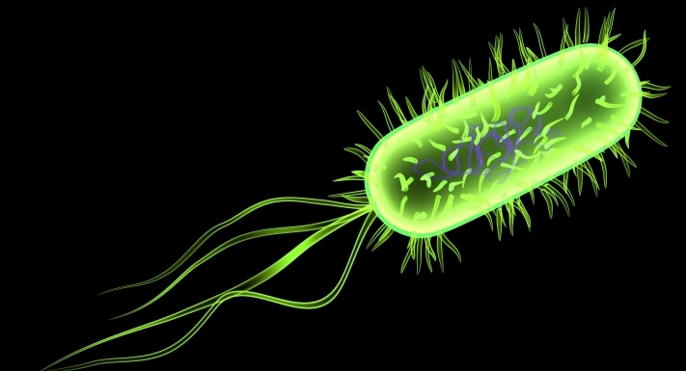
Cleaning Method – Order of Preference
No cleaning needed
Redundant or dedicated equipment (isolated)
Purge (next product or inert material)
Dry clean
Dry clean w/chemicals
CIP (Clean in Place)
Controlled wet clean – out of place
Automated washer
ACS (Assisted Cleaning System)
Controlled wet clean – in place
Flood cleaning
Notes:
**ENGLISH**
1. The ideal state is to design for no cleaning as cleaning is not a value-added process for our consumer (see Value Stream Mapping). However, it is a critical process to providing safe quality food, but we should work to minimize its impact to the business as much as possible. Creating systems with redundant and dedicated equipment help drive down Planned Losses.
Examples:
dedicated equipment to a specific allergen to prevent the need to clean and inspect the system related to removing that specific protein the significant resources need to meet that goal.
Redundant equipment so that it can be pulled offline quickly during a flavor changeover and replaced for a faster start up of the system
2. Purging they system to remove most, but not all, of the product/ingredient to meet the changeover success criteria. A clear standard of how much remaining material can be left in/on the system needs to be clearly agreed to and communicated (photo standards, etc).
Examples:
Pushing the previous product with the next formula for a given time/weight/volume to meet a sensory standard (removing color, flavor, etc)
Flushing with an inert material like salt to help abrade away the previous material
Dry cleaning with no water or chemicals should be prioritized to minimize the impact of water and chemicals on our people, equipment, and the environment. We want to collect the soil not spread it so use of compressed air is strongly discouraged. Vacuum, scrape, or brush the soil to efficiently and effectively get it into a waste container.
Dry cleaning with chemicals to help loosen/release the soils may be needed in some cases.
If water use is absolutely necessary then having a fully automated, closed loop system is the best option to control the key steps and parameters of cleaning.
If possible, move equipment for wet cleaning to an area designed for cleaning and control water. The first choice is to utilize an automated washer (cabinet, tunnel, etc) to ensure reparability and control of all steps and parameters. Automated cleaning is always preferred to the variability of human cleaning tasks.
Assisted Cleaning Systems are closed loop system without full automation like CIP and require more resources to manage.
If the components can’t be moved to a wash area, then clean in place methods like utilizing a bucket and brush must be used. It is preferred to control the cleaning process and not spread the soil and water to a larger area (example wiping off your kitchen table instead of spraying it down with a hose)
Flood cleaning requires huge volumes of water, special training, and PPE. It spreads the cleaning process to a much larger area than what was dirty to start with.
Option 1. generally will have the lowest impact to cost and micro risk vs. option 9. being the most costly and highest risk for micro growth.

Slide 4
Método de Limpeza – Ordem de Preferência
Nenhuma Limpeza Necessária
Equipamento redundante ou dedicado
Purga/Empurre (próximo produto ou material inerte)
Limpeza seca
Limpeza seca com químicos
CIP (Clean in Place)
Limpeza úmida controlada – fora do local (“out of place”)
Lavadora automática
ACS (Sistema de Limpeza Assistida)
Limpeza úmida controlada – no local (“in place”)
Limpeza úmida
Notes:
**PORTUGUESE**
1. O estágio ideal é desenhar o sistema para não ter limpezas uma vez que limpezas não são valores agregados no processo, para nossos consumidores (veja o “Value Stream Mapping” – Mapeamento de Fluxo de Valor). Entretanto, é um processo crítico para fornecer alimentos seguros e de qualidade, mas devemos trabalhar para minimizar ao máximo seus impactos no negócio. Criar sistemas com equipamento dedicado e redundante ajuda a reduzir Perdas Planejadas.
Exemplos:
Equipamento dedicado para um alergênico específico de forma a evitar a necessidade de limpeza e inspeção do sistema relacionado a remoção desta proteína específica, os recursos significativos precisam atingir este objetivo.
Equipamento redundante para que possa ser desligado facilmente durante uma troca de sabor e substituído para uma inicialização (start up) do Sistema.
2. Purgar o Sistema para remover a maioria, mas não todo, o produto/ingrediente de forma a atingir o critério de sucesso da troca/changeover. Um padrão claro de quanto material remanescente pode ser deixado no Sistema precisa estar claramente acordado e comunicado (fotos padrões, guias, etc.)
Exemplos:
Empurrar o produto anterior com a formula seguinte por um determinado tempo/peso/volume para atingir um padrão sensorial (remoção de cor, sabor, etc.).
“Lavar” com um material inerte como sal para ajudar a eliminar o material anterior.
Limpeza seca sem água ou químicos deve ser priorizada para minimizar o impacto da água e dos produtos químicos para nossas pessoas, equipamento, e o meio ambiente. Queremos coletar os sólidos residuais e não espalhar então o uso de ar comprimido é fortemente desencorajado. Aspire, raspe, ou escove o sólido para colocá-lo de maneira eficiente e eficaz em um recipiente de resíduo.
A limpeza seca com químicos para ajudar a soltar/liberar os sólidos pode ser necessária em alguns casos.
Se o uso de água for absolutamente necessário então ter um sistema de circuito fechado totalmente automático é a melhor opção para controlar as principais etapas e parâmetros da limpeza.
Se possível, mova o equipamento para limpeza úmida para uma área designada para limpar e controlar a água. A primeira opção é utilizar uma lavadora automática (gabinete, túnel, etc) para garantir reparabilidade e controle de todos os passos e parâmetros. Limpeza automática é sempre preferível por conta da variabilidade das tarefas de limpeza humanas.
Sistemas de Limpeza Assistida são um sistema de circuito fechado sem automação completa como o CIP e requerem mais recursos para gerenciar. Se os componentes não puderem ser movidos para uma área de lavagem, então métodos de limpeza no local com baldes e escovas devem ser utilizados. É preferível controlar o processo de limpeza e não espalhar os sólidos e água para uma área maior (por exemplo, passar pano na mesa da cozinha em vez de borrifá-la com uma mangueira)
Limpeza totalmente úmida requer grandes volumes de água, treinamento especial e EPIs. Ela espalha o processo de limpeza para uma área muito maior do que a que estava suja inicialmente.
Opção 1. geralmente terá o menor impacto no custo e risco microbiano contra opção 9. sendo a mais custosa e de maior risco no crescimento microbiano.

